Slide 1
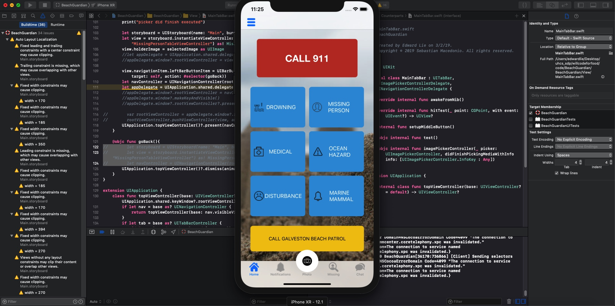
Edward – Week 5 (1)
This past week consisted of fixing and updating code in XCode to meet feature goals.
The most significant change was the replacement of the camera icon from the first few iterations with a rounded button using a UITabBar class file.

Slide 2
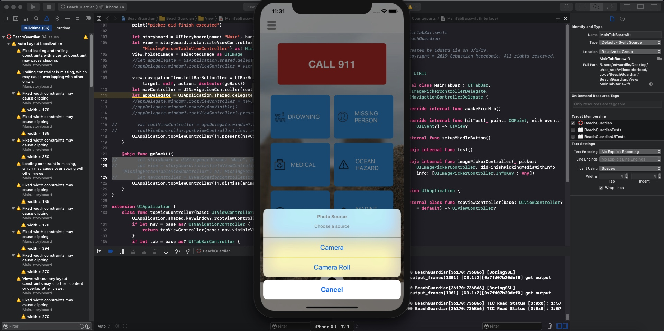
Edward – Week 5 (2)
Activity monitor constraints added
Added new file for rounded button
Moved logic from PhotoViewController to new file
Attached “Take Photo” button to storyboard so user can take photos from main page and missing person form.

Slide 3
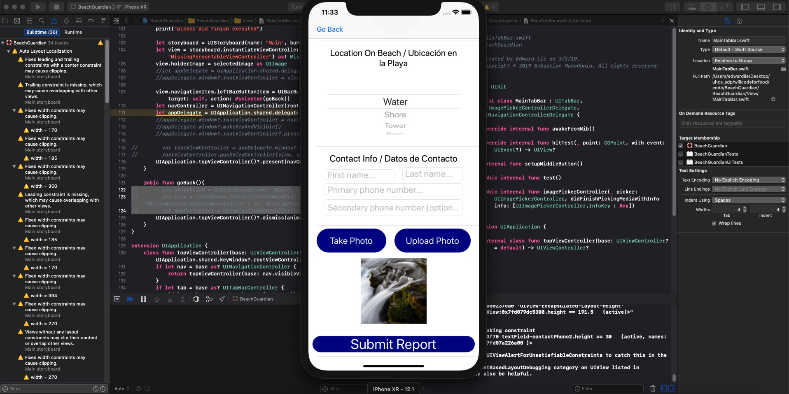
Edward – Week 5 (3)
Added way to go back and forth between phot camera library and missing person form allowing user to change his/her mind for picture they want to upload in missing person form
My week 6 goal is to resume testing now that all necessary functionality is complete. Some minor UI changes are also in the backlog, but these all of less priority.

